Slide 1



Farming Assistant
01

Slide 2



Team Members
Anupa Das Shormi
BFH1925020F
Ishrat Jahan Rintu
BFH1925002F
Md Alamgir Hossain
ASH1925016M
02

Slide 3

Supervised By
Tasniya Ahmed
Assistant Professor
Institute of Information Technology
Noakhali Science and Technology University
7
03

Slide 4

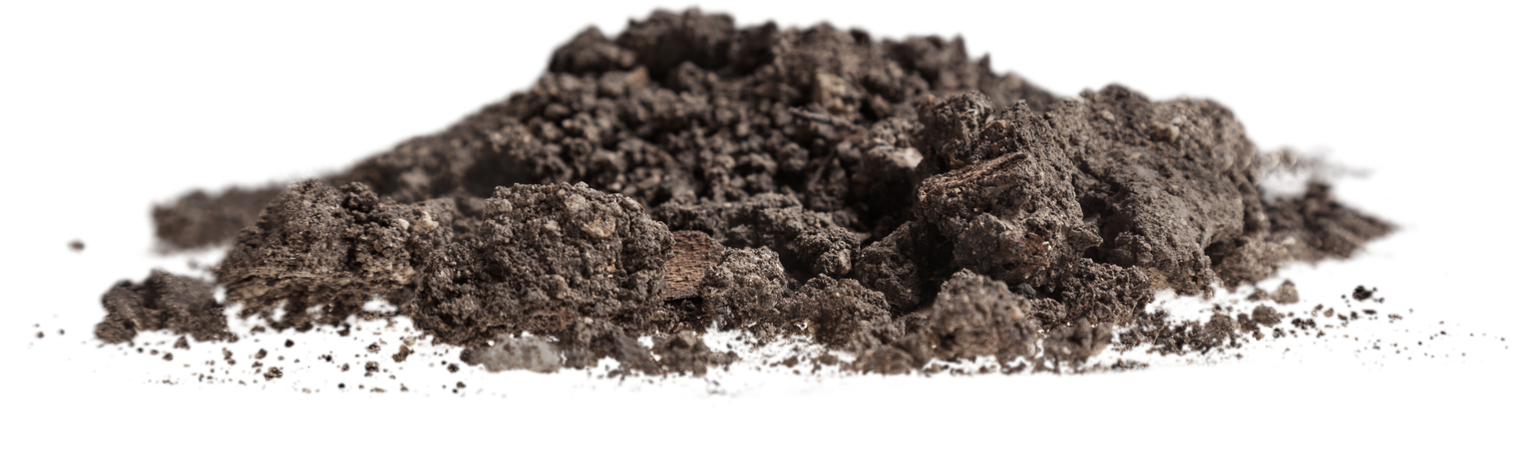
Presentation Agenda
Introduction
Features
Stakeholders
Why use this application
User Interface
Future Work
04

Slide 5
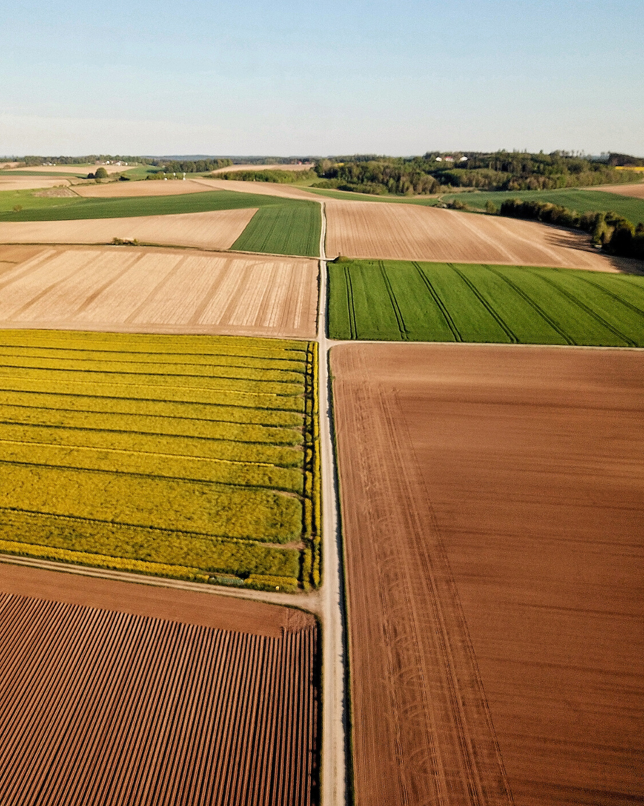
Introduction
Farming Assistant is a web application which helps as an assistant to the farmers by providing various kinds of agriculture related information and services like online market place. Farmers also can seek help about farming related problems and get solutions.
About 87 percent of rural households rely on agriculture for at least part of their income[1]. Among them 60% farmers use cell phone, 46.9% had SSC certificate, 37.4% passed primary,15.7% were above SSC [2]. Also 41 percent of mobile phone users had smartphones in Bangladesh [3].
So the main purpose of developing this system is for the welfare of the farmer and advancement of agricultural sector.
05

Slide 6
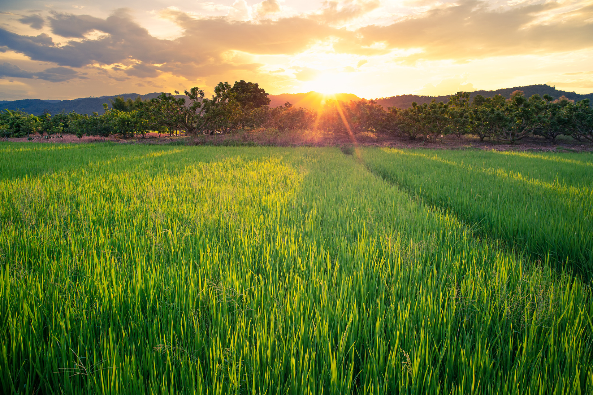



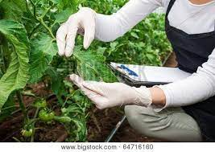

Stakeholders
Farmer
Customer
Agriculturist
Admin
06

Slide 7




Features
Blogs
Help Desk
Agriculture related tips, information are provided as blogs.
Farmers can seek help about farming related problems and get solutions from the experts.
News
Online marketplace
Latest govt notices are
provided in the notice section.
Farmers can sell their products online.
07

Slide 8


Why use this system
Farmers can sell their products and also can get the agricultural notices and tips at the same platform . Also they don’t need to access various website for government notices.
Help the farmers by providing easy access and effective utilization of agricultural information and news.
Provides a wider market to the farmer to sell their products by cutting down the mediator.
Our system interface is very user friendly even a novice person can use it.
08

Slide 9
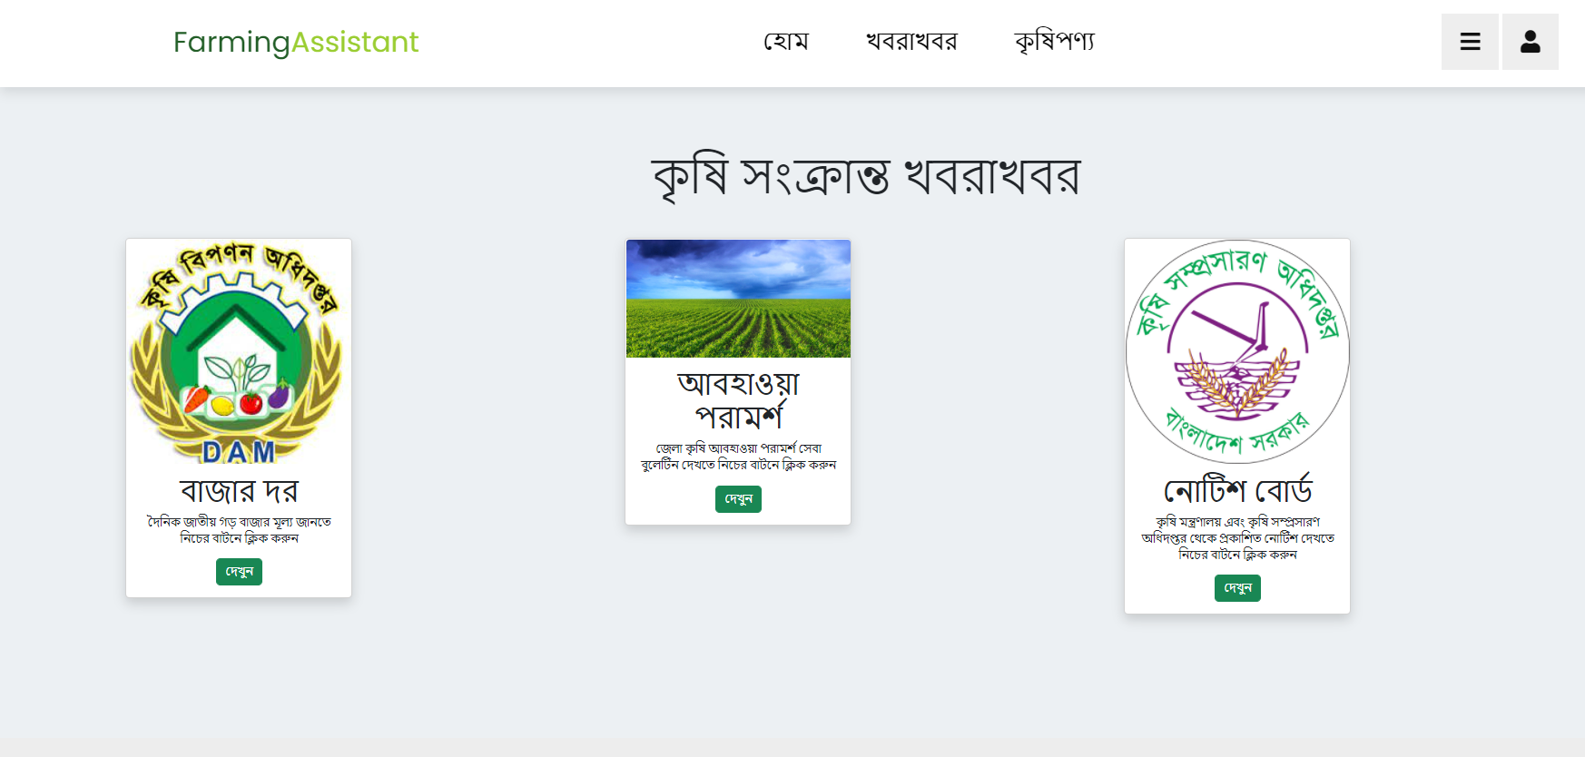
User Interface(Notice)
By clicking on the “খবরাখবর” option from the navigation bar users can see the latest Govt notices,district wise weather information and division wise live market price of various farm products.
09

Slide 10
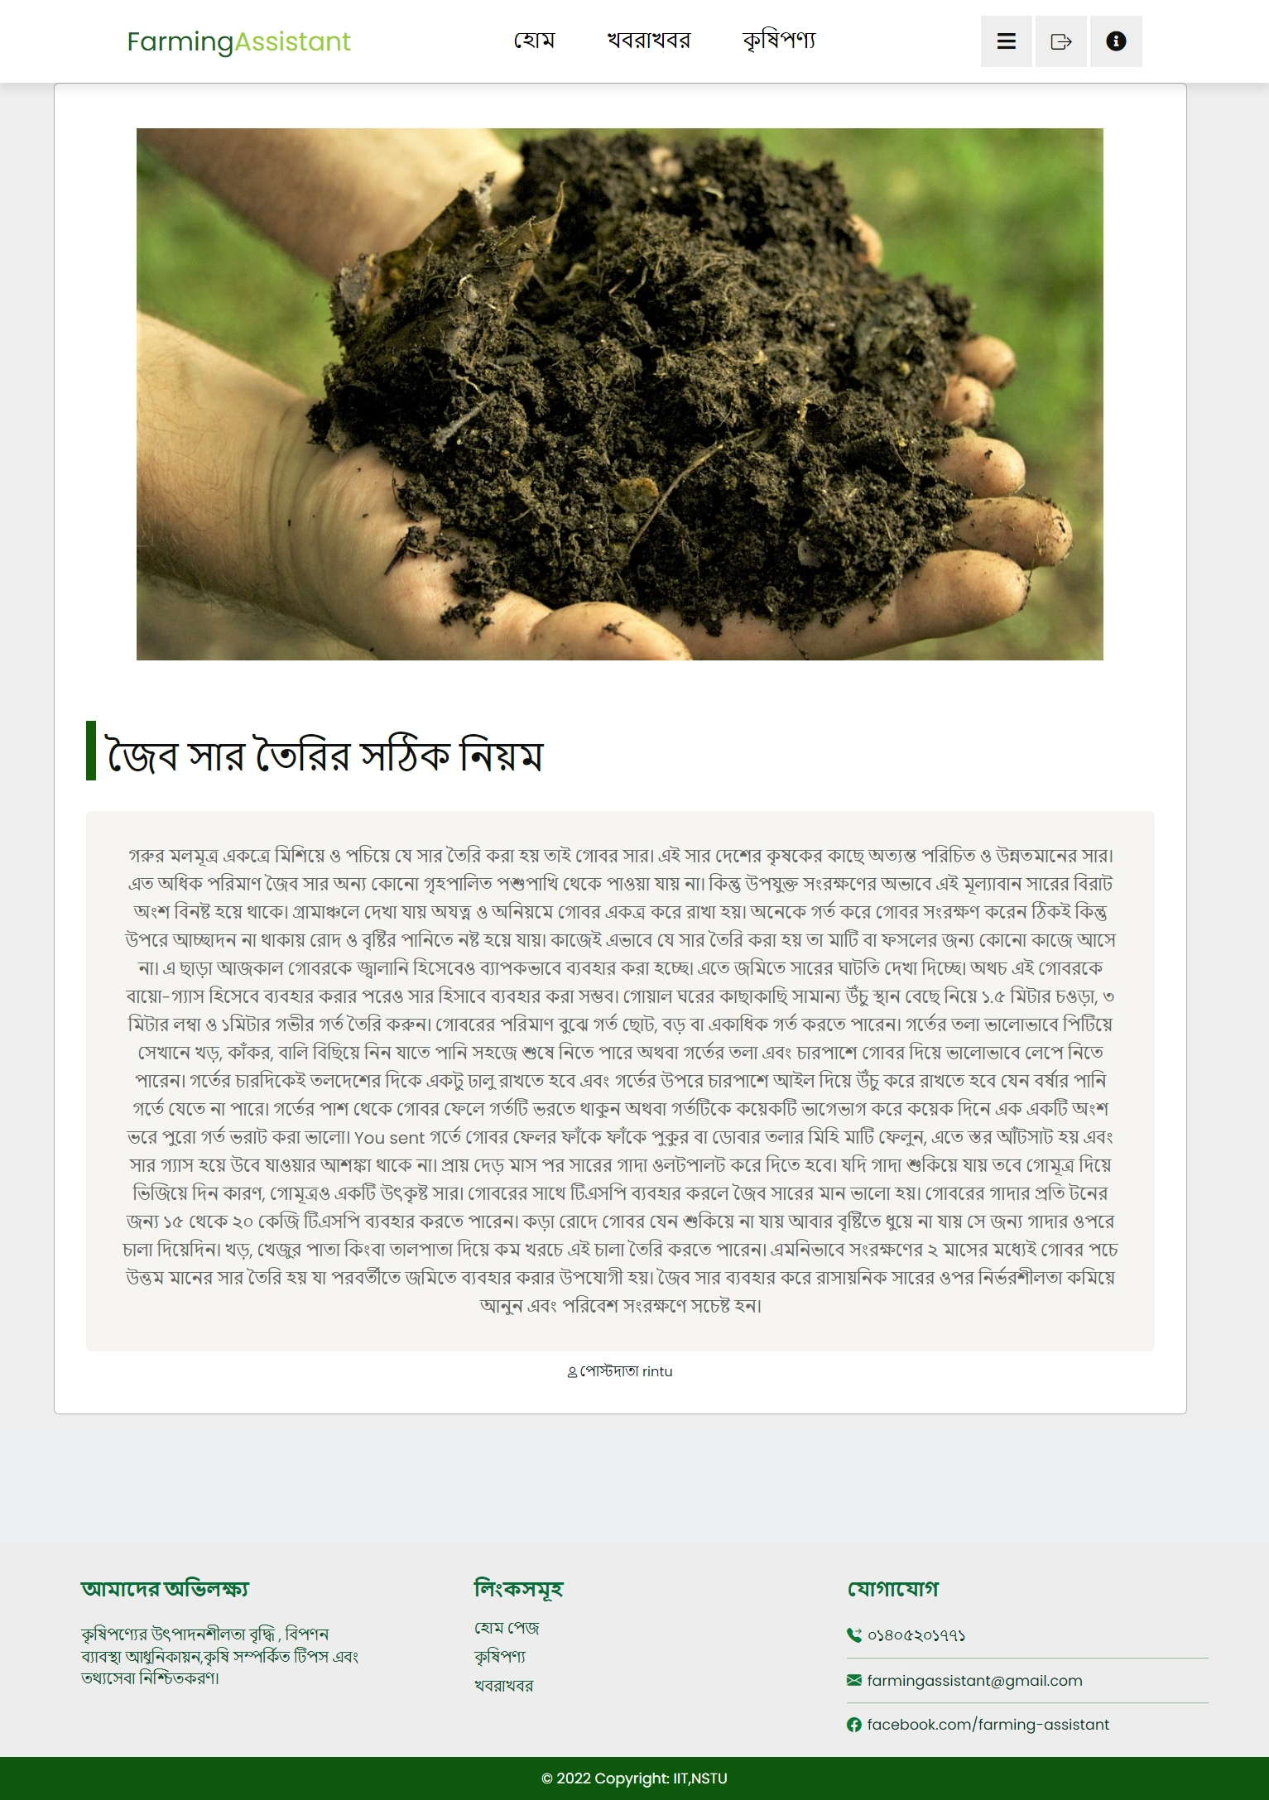
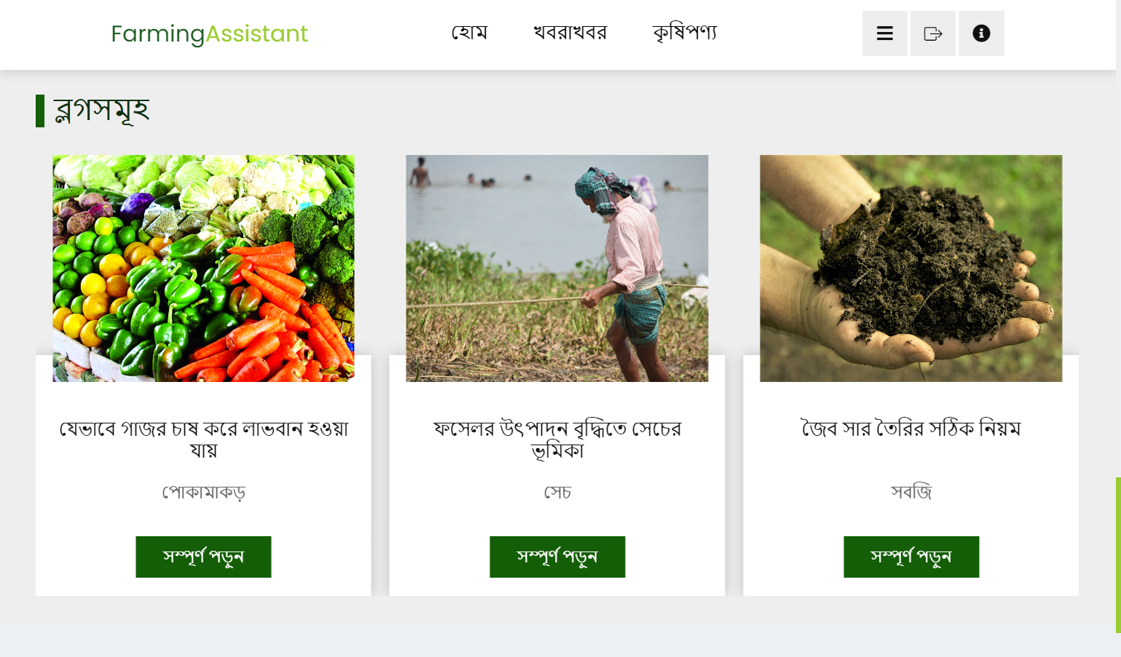
User Interface(Blogs)
Users can see the blogs uploaded by the agriculturists from the bottom of the home page. By clicking on the blogs users can view the blogs in detail.
10

Slide 11
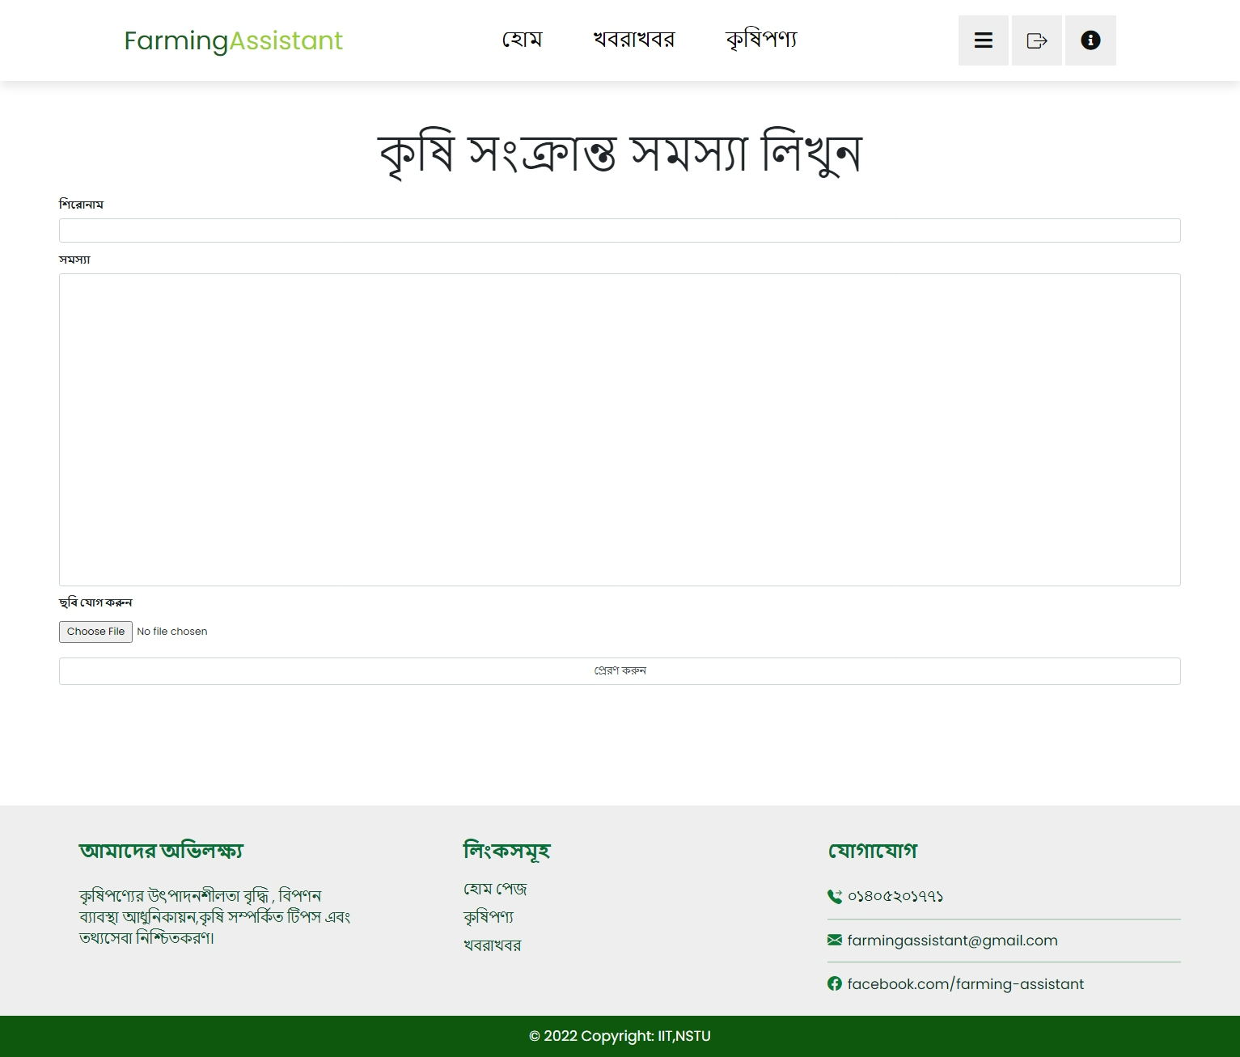
User Interface(Seek help)
Farmers can seek help about various agriculture related problems by clicking on the “সমস্যা বলুন” option from the sidebar.
11

Slide 12
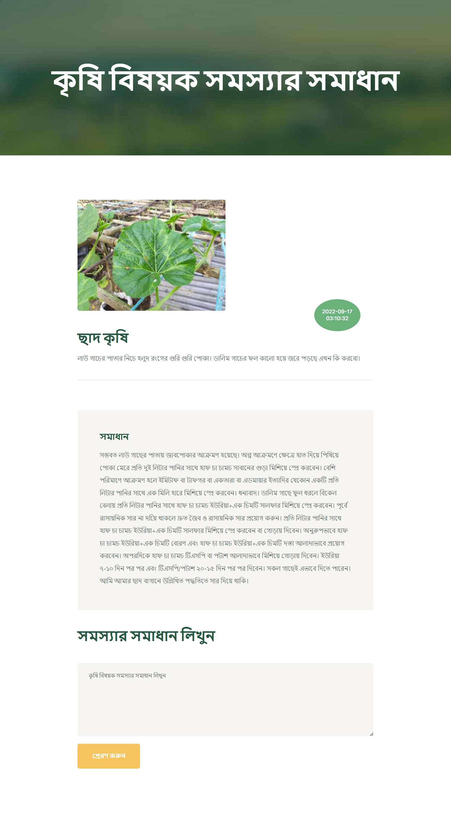
User Interface(Give solution)
Agriculturists can give solution to the problems posted by the farmers.
12

Slide 13
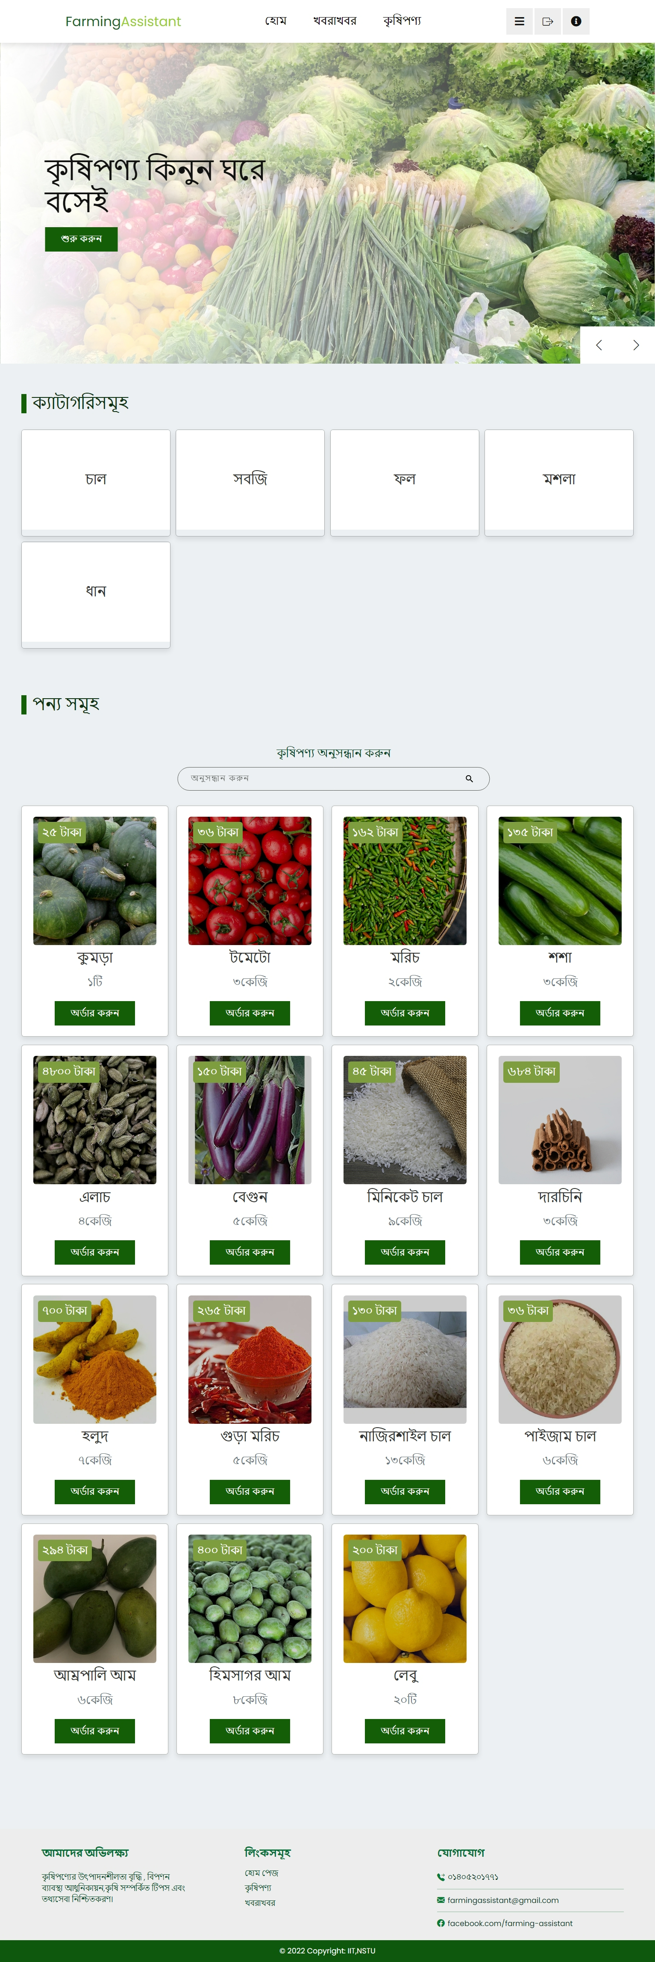
User Interface(Marketplace)
To view the online marketplace and purchase farm products from the farmers, the users should click on the “কৃষিপণ্য” option from the navigation bar and the categories of the products will be appeared.
13

Slide 14
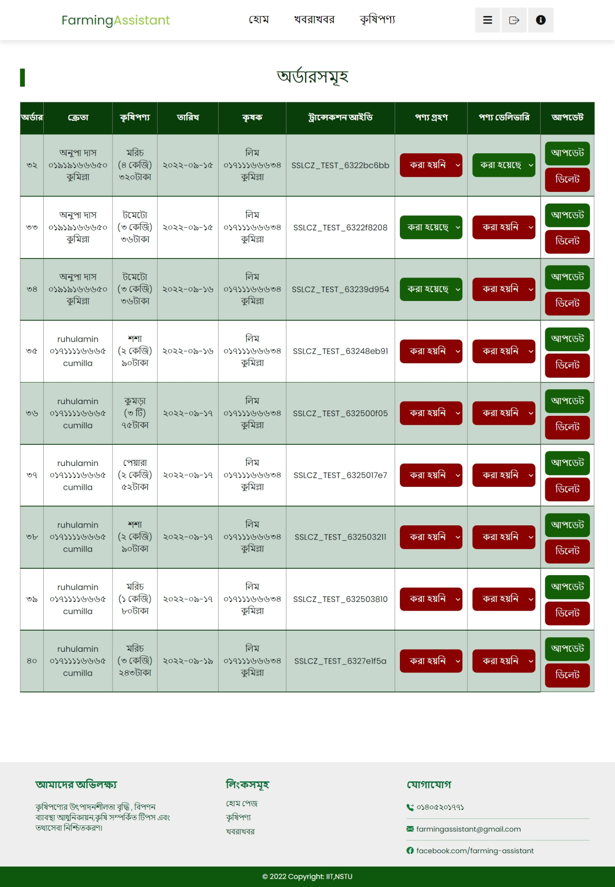
User Interface(Orders)
Admin can keep track of all the placed orders and update the order status.
14

Slide 15
Future Work
To make the application more convenient for the farmers we will try to add some features in the future like video call , voice search.
15

Slide 16
Team Contribution
Task | Modules | Active Members
Coding | Marketplace, Admin module, Blog, Registration, Login, Edit Profile | Ishrat Jahan Rintu
 | Notices, Seek Help , Post Solution | Anupa Das Shormi
 | Marketplace (Front-end ) Blog Page(front-end) Registration ,Login Page(front-end) | Md. Alamgir Hossain
System Integration |  | Ishrat Jahan Rintu, Anupa Das Shormi
Testing And Debugging | Marketplace, Blog | Ishrat Jahan Rintu
 | Notices, Seek Help, Post Solution | Anupa Das Shormi
Slide preparation and product brochure Preparation |  | Ishrat Jahan Rintu, Anupa Das Shormi, Md Alamgir Hossain
16

Slide 17
References
1.https://www.worldbank.org/en/results/2016/10/07/bangladesh-growing-economy-through-advances-in-agriculture
2. Mamun-Ur-Rashid, Md Karim,Md Soad, “The Usefulness of Cell Phones for Crop Farmers in Selected Regions of Bangladesh”. Asian Journal of Agriculture and Rural Development, 2019.
3.https://www.thedailystar.net/backpage/news/bangladesh-behind-nepal-pakistan-smartphone-use-2069457
Md Abul Kashem, Mohammad Abdullah Al – Faroque, “Agricultural Technology: A Challenge To Way Forward Sustainable Development”. Bangladesh Journal of Agriculture,2010
17

Slide 18
Thank
You
18

